Slide 1

Description & Implementation of the ACMI Component
A Hardware Accelerator for the Vision Transformer Algorithm using MinHash to Lineage assignment by ENICS Lab Final Project - Computer Engineering, BIU
Noam Diamant & Itay Goldberg Academic Supervisor : Prof. Leonid Yavits Instructor : Itay Merlin August, 2024

Slide 2
Introduction
The Goal - Lineage assignment, identifying and categorizing the lineage or variant of the COVID-19 virus.
The Method – ViTAL, A NN-based algorithm proposed as an accurate and efficient solution.
Our Focus - MinHash, technique used to estimate the similarity between two sets efficiently. A preprocessing step that feature extraction of the DNA (FASTA files).

Slide 3
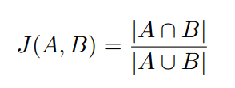
Background - MinHash
Goal - Approximate the similarity between two datasets
Assumption - probability of two sets have the same minimum hash value is equivalent to their Jaccard similarity.
Jaccard similarity measures the proportion of shared elements between two sets

Slide 4
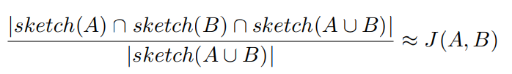
Background - MinHash
We will activate a uniform Hash function
We will get an estimate of the Jaccard similarity.
Instead of calculating the entire genome in this way, we select the K signatures with the lowest value for expansion and processing in a neural network

Slide 5
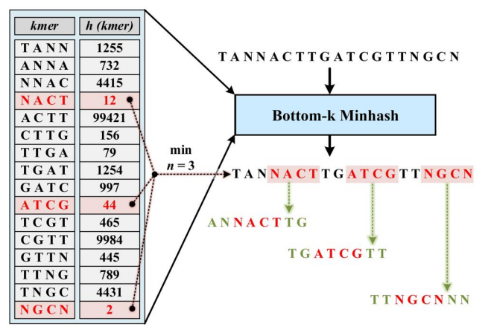
Background - MinHash

Slide 6
Existing Solutions
UShER :
Places new samples on an existing phylogenetic tree
More effective at higher coverage levels (4x and above)
Kraken2:
Uses k-mer matching for classification
Relies on exact k-mer matching, which can be problematic for erroneous DNA reads
Less effective at distinguishing between closely related SARS-CoV-2 lineages
Performance decreases significantly at lower coverage levels

Slide 7
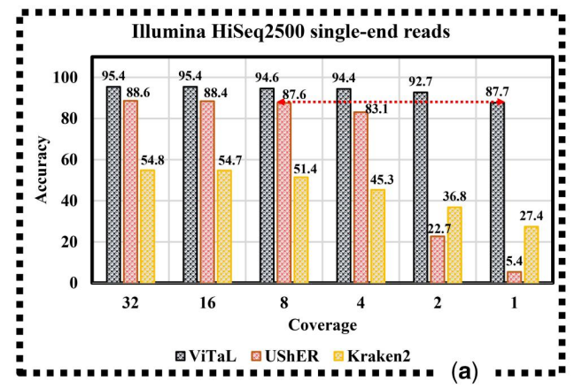
Comparing accuracy as a function of coverage

Slide 8
Properties of the ACMI-accelerator
System/Configuration | Time to Place Single Genome | Speedup vs UShER | Memory Usage
ACMI-accelerated ViRAL | 2.81 ms | 69.4× | Not specified
GPU-accelerated ViRAL (RTX 2080 Ti) | 54.79 ms* | 3.53× | ~5 GB
Software-only ViRAL (Intel i7-9700K) | 94.42 ms* | 2.06× | ~3.74GB
Kraken2 | 104 ms | 1.8× | ~3.7GB
UShER | 195 ms | 1× | ~0.5 GB**

Slide 9
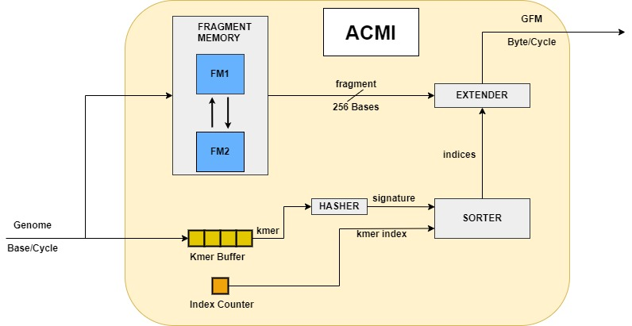
ACMI implementation

Slide 10
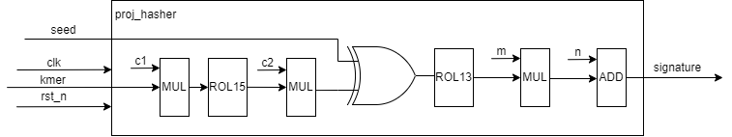
Hasher

Slide 11
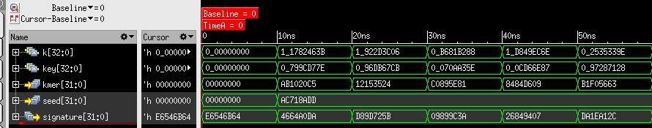
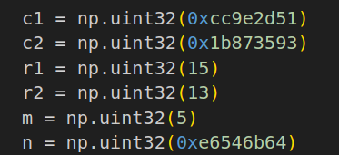
Hasher
$$k=c2∗Roll_{15}\left(c1∗0xAB1020C5\right)=c2∗Roll_{15}\left(0x\text{2}\text{B}\text{72}\text{FF}\text{55}\right)=c2∗0x7FAA95B9=0x1782463B$$
$$signature=m∗Roll_{13}\left(0xAC718ADD⊗k\right)+n=m∗Roll_{13}\left(0xBBF3CCE6\right)+n=m∗0x799CD77E+n=0x4664A0DA$$

Slide 12
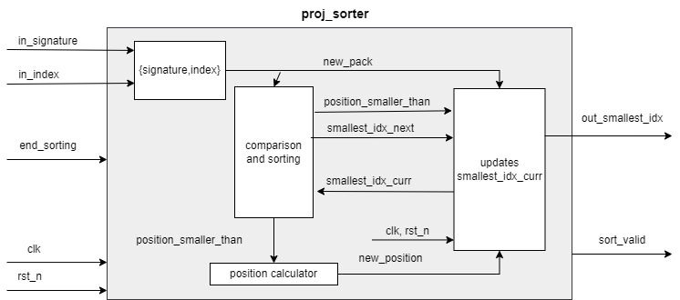
Sorter

Slide 13
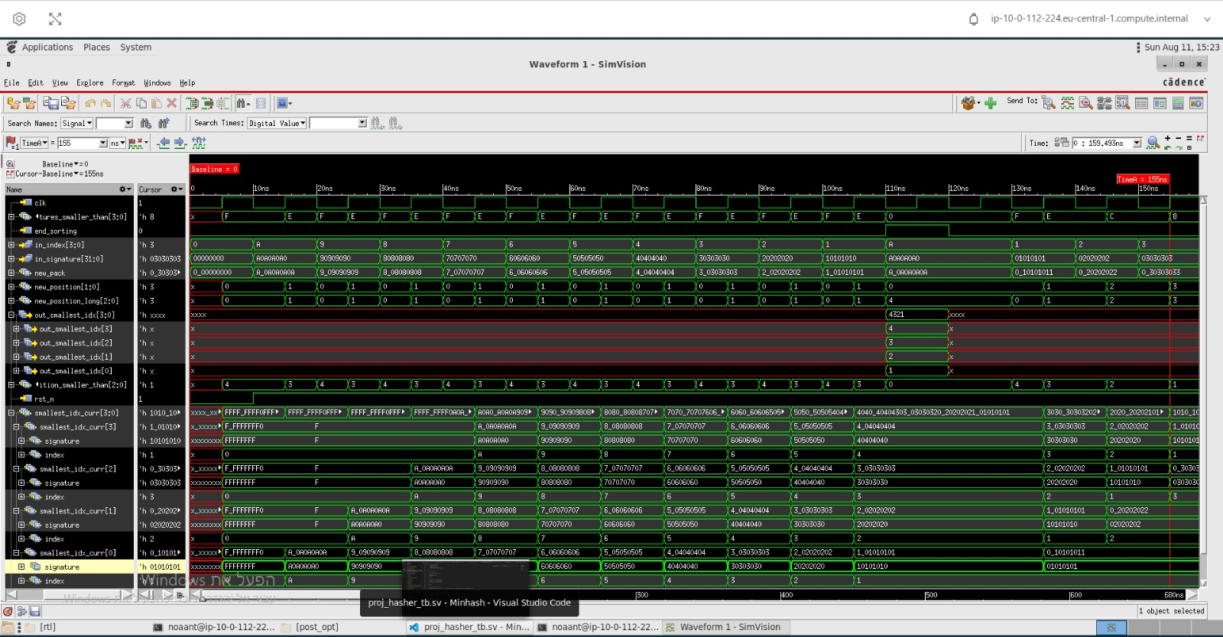
Sorter

Slide 14
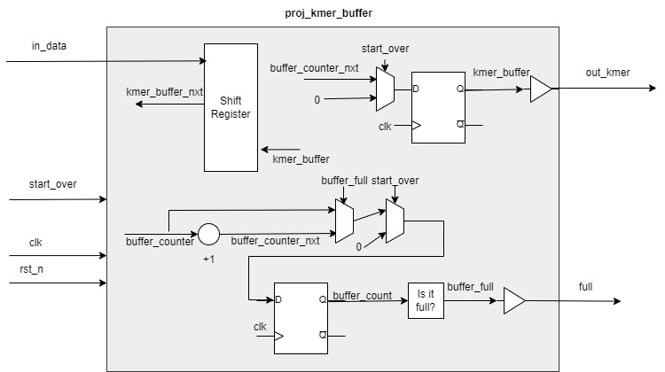
Kmer Buffer

Slide 15
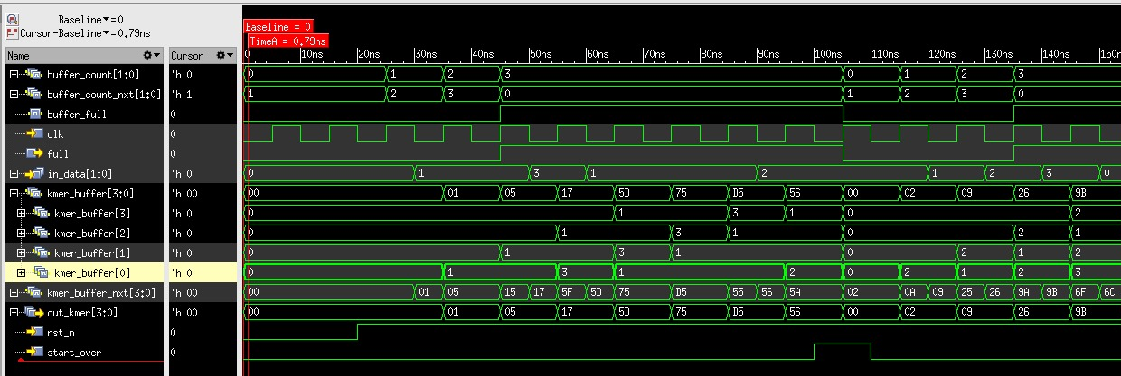
Kmer Buffer

Slide 16
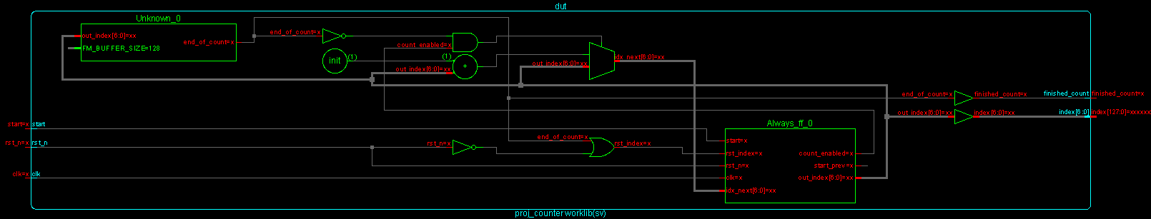
Index Counter

Slide 17
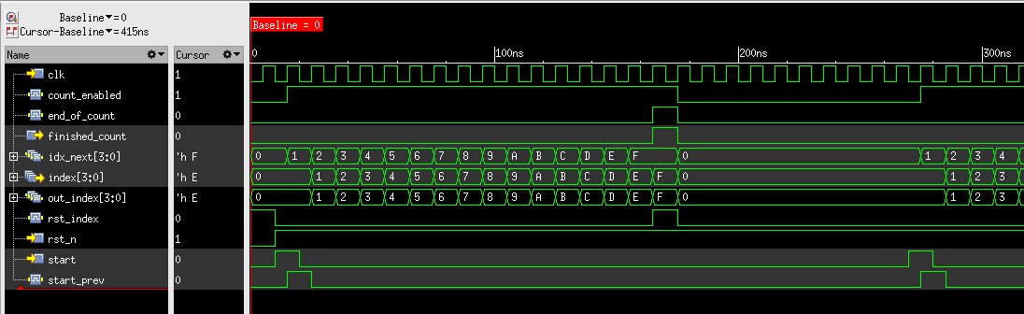
Index Counter

Slide 18
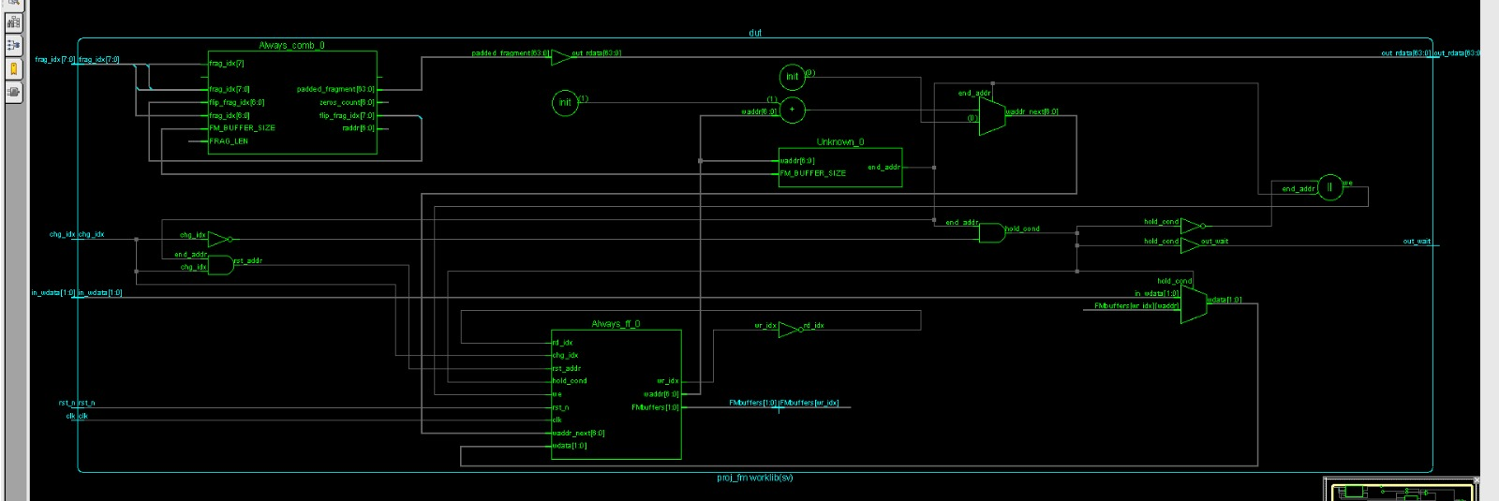
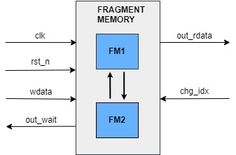
Fragment Memory

Slide 19
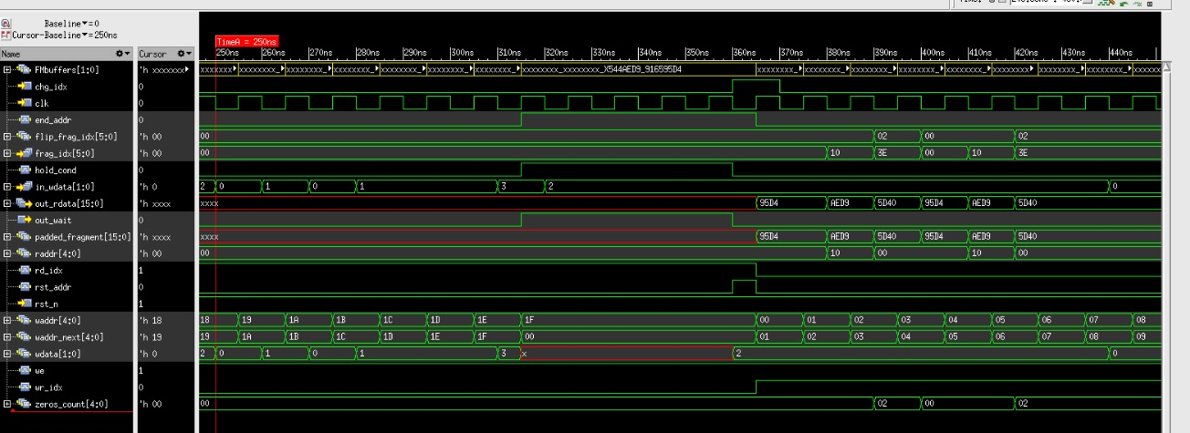
Fragment Memory

Slide 20
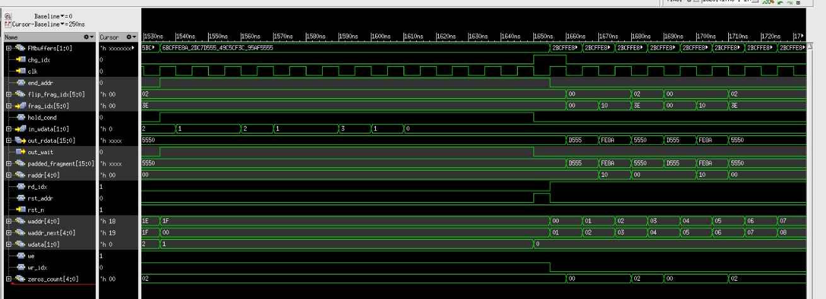
Fragment Memory

Slide 21
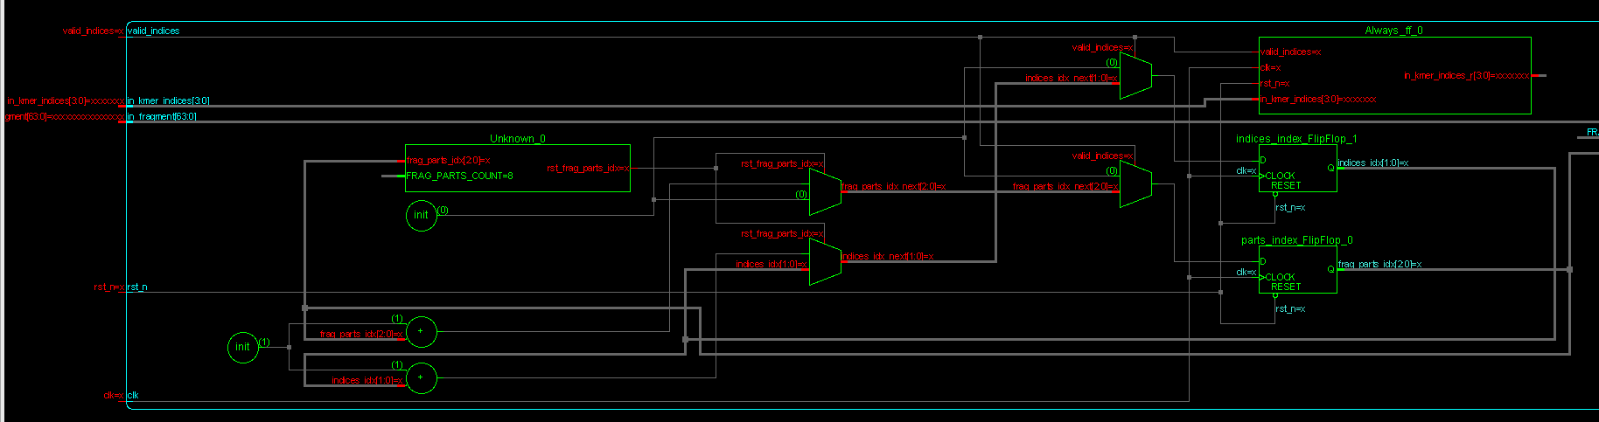
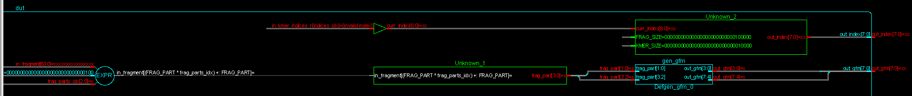
Extender

Slide 22
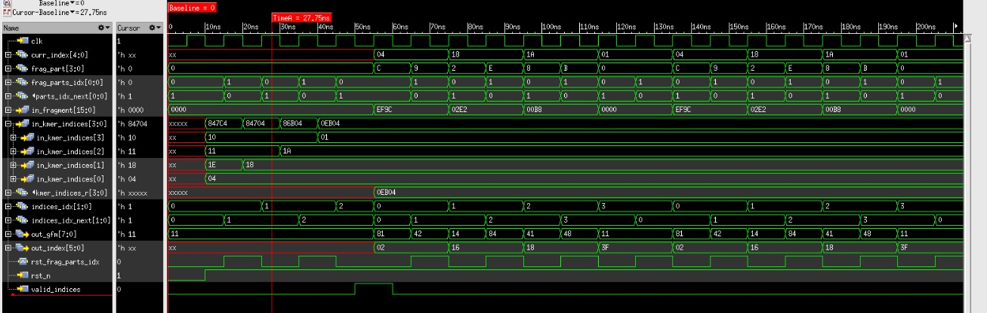
Extender

Slide 23
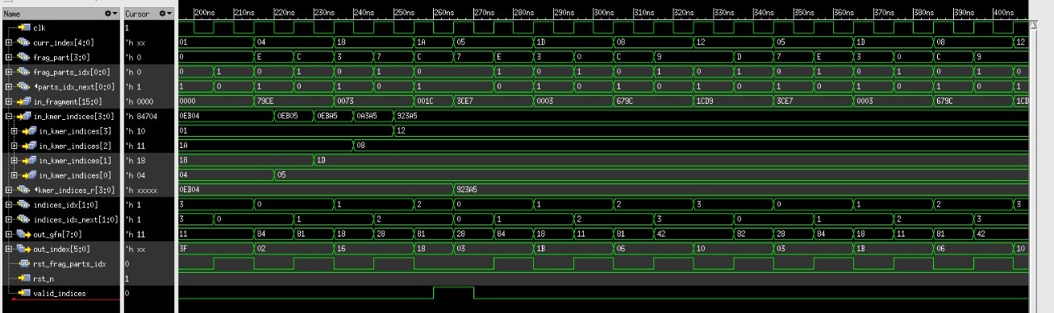
Extender

Slide 24
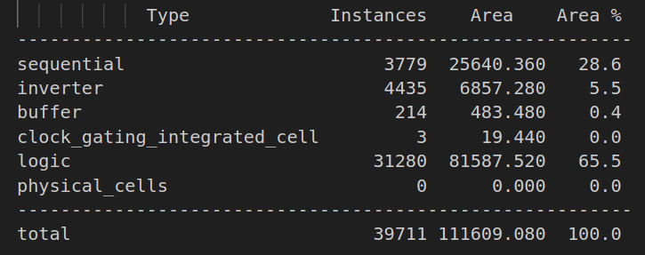
Synthesis
Area

Slide 25
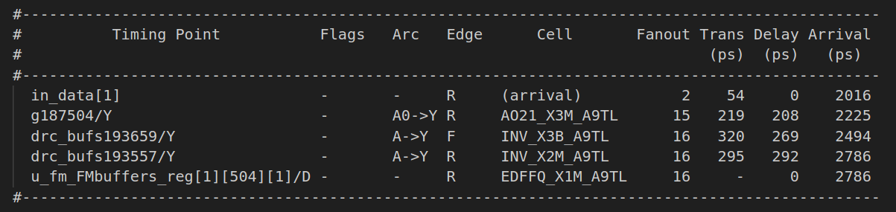
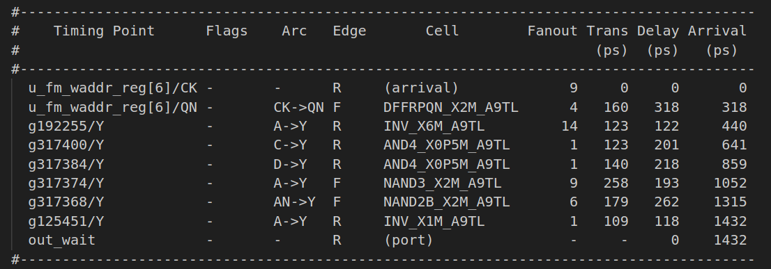
Synthesis
in2reg
reg2out

Slide 26
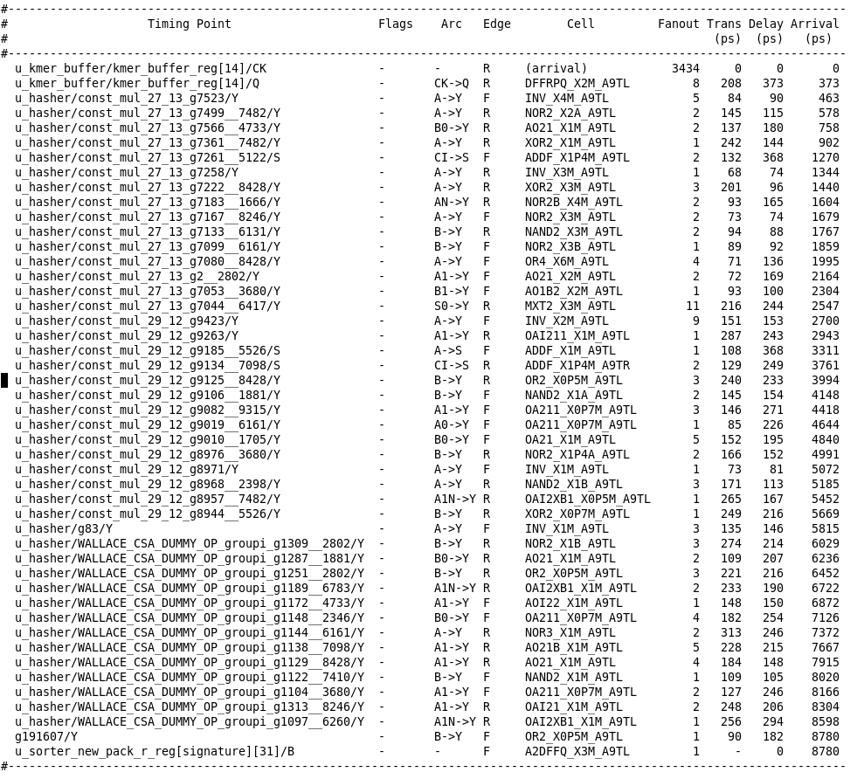
reg2reg

Slide 27
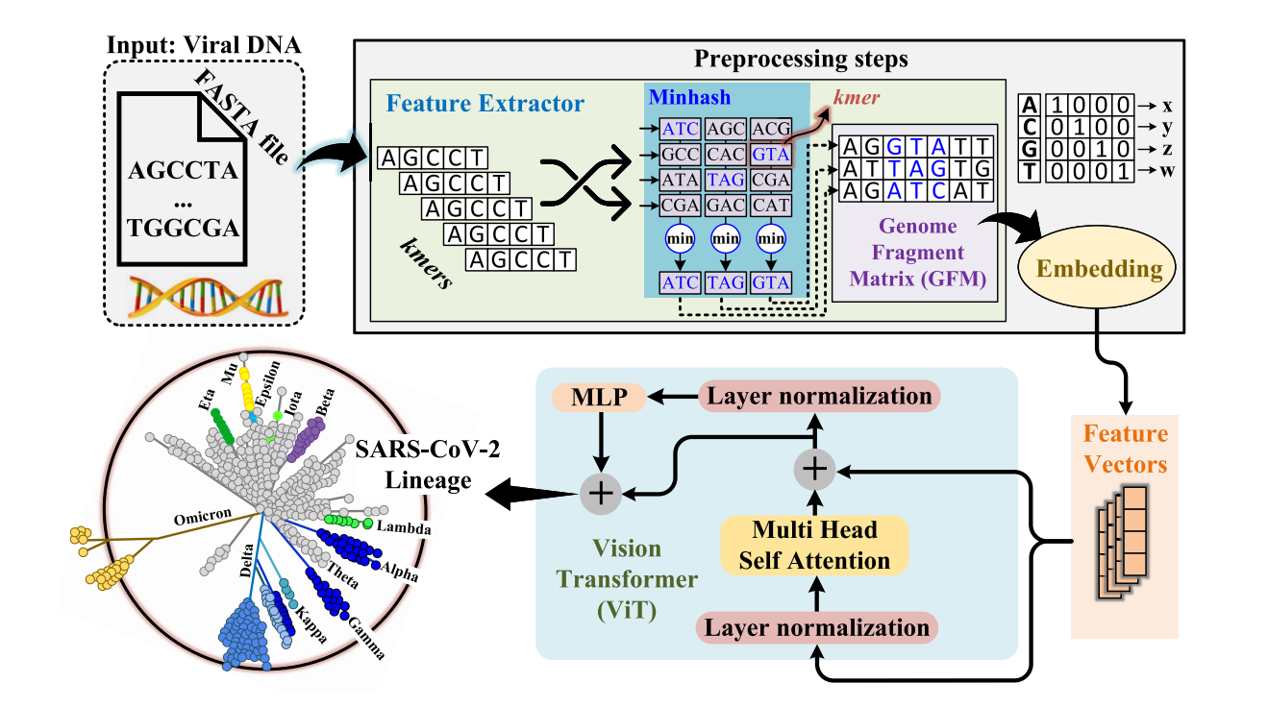
Summary

